Slide 1
CSPH Faculty Orientation
Updated May 1, 2024

Slide 2
Table of Contents
Introduction to CSPH
CSPH Research Fellowship Program
CSPH Cores and Resources
Data Acquisition Process
Faculty Expectations

Slide 3
An Introduction to CSPH

Slide 4
CSPH lies at the Intersection of Surgery and Public Health
Our work at CSPH brings together the following fields:
Health Services Research: research that examines access to, and the use, costs, quality, delivery, organization, financing, and outcomes of health care services to produce new knowledge about the structure, processes, and effects of health services for individuals and populations
Clinical Outcomes Research: research that seeks to identify and measure the link between treatments or interventions delivered and the actual outcomes achieved
Epidemiology of Surgery: the study of the distribution and determinants of health-related states or events in specified populations and the application of this study to the control of health problems, specifically related to surgery
Health Services Research
Clinical Outcomes
Research
Epidemiology of Surgery
Notes:
HSR = IOM
Clinical outcomes research = HSPH
Epid of Surgery - WHO

Slide 5
Our Mission & Goals
Expand & Disseminate Knowledge
To advance high-quality, equitable, and person-centered surgical care in the U.S. and worldwide through impactful research that transforms surgical practice and develops leaders in surgical health services research.
Transform Practice
Engage the Policy Community
Train Future Leaders
Build a Culture of Excellence

Slide 6
Our Values
CSPH accomplishes its mission by living and modeling our values, which is how we will treat and act towards each other.
V | Value all voices in the work of improving surgical care.
I | Invest in future generations of surgical researchers.
T | Treat each other with equal respect and dignity.
A | Advocate for both patients and each other through inspiration and encouragement.
L | Lead with integrity in the conduct and execution of our science and advocacy efforts.
S | Strive to foster a collaborative and supportive research environment.

Slide 7
CSPH is Committed to a Safe and Equitable Workplace
We promote a positive environment and just culture in our research workplace by:
Committing to diversity, equity, and inclusion
Adhering to authorship guidelines
Providing training on equity in the workplace
CSPH adheres to and supports the Brigham and Women’s Hospital and Harvard Medical School statements on Diversity, Equity, and Inclusion
Learn more about the STARS, CURE, and SSJP programs at Brigham and Women’s Hospital
CSPH adheres to and supports the use of ICMJE Authorship Guidelines.
CSPH offers:
Unconscious bias training
The Justice, Equity, Diversion, and Inclusion (JEDI) Workshop Series
All research team members who make qualifying contributions to data acquisition and analysis should have the opportunity to contribute to writing or critical review.
Notes:
Move?

Slide 8
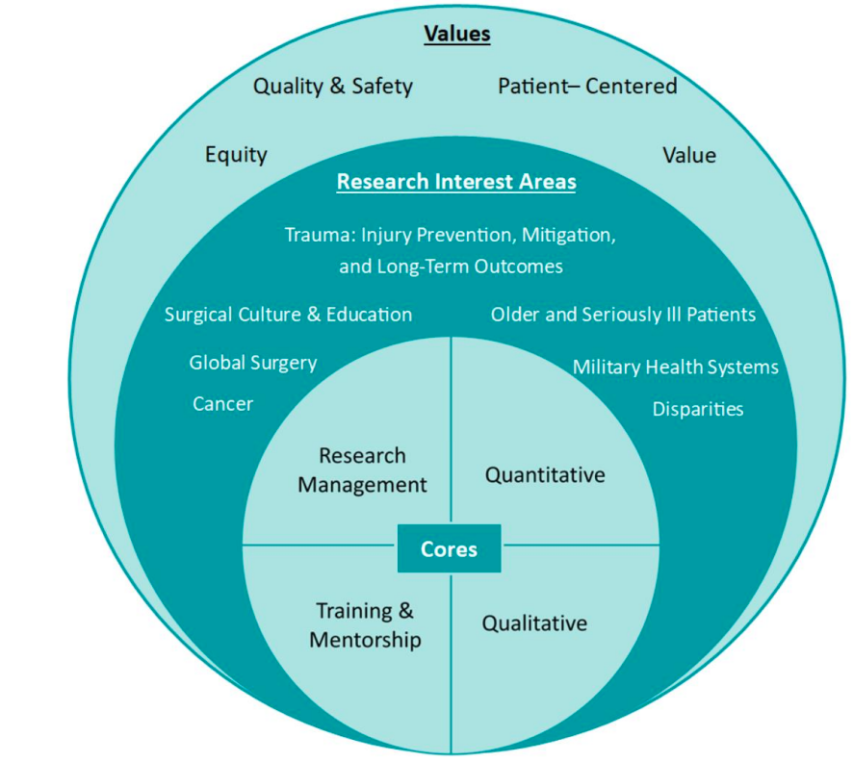
Research Structure
All research, policy, and advocacy efforts within CSPH are guided by our common values.
CSPH has several research interest areas which reflect the investigative pursuits of our faculty and staff; these provide a forum to facilitate conversations, projects, and collaboration.
CSPH is organized into four internal cores. Each of these cores provide resources and expertise to support CSPH research.

Slide 9
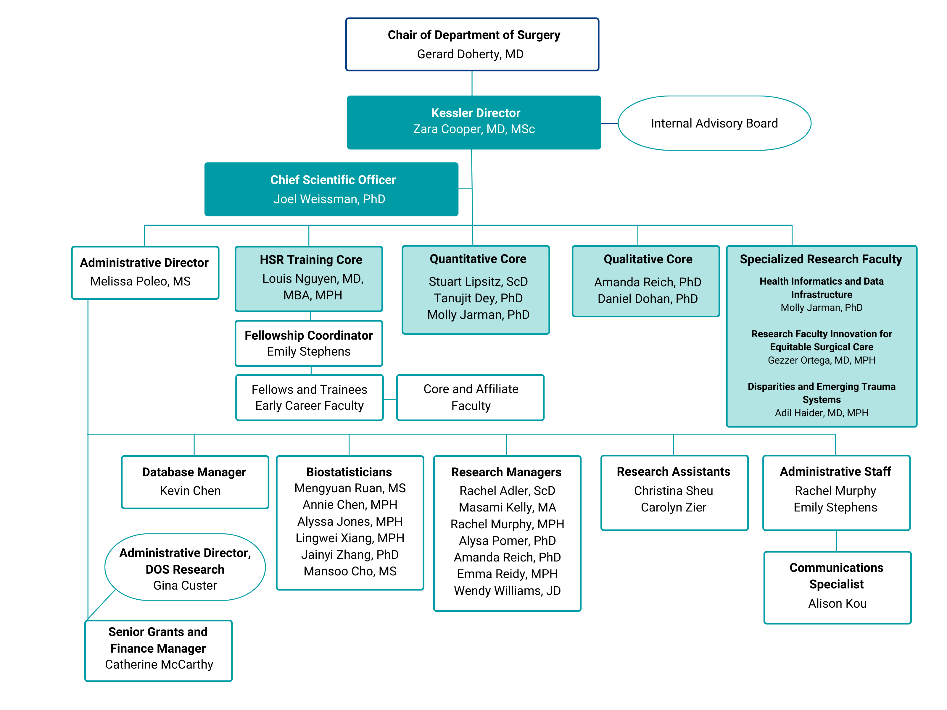
Organizational Structure

Slide 10
Internal Advisory Board
The Internal Advisory Board, led by Kessler Director Zara Cooper, consists of core faculty members, fellows, and research staff who guide the overall mission and direction of research conducted at CSPH.
They regularly meet to discuss faculty projects and provide oversight of the Center’s overall strategic plan.
Executive Committee
Research, Data & Admin Staff
Affiliate Faculty
Core
Faculty
Internal
Advisory
Board
Research Fellows

Slide 11
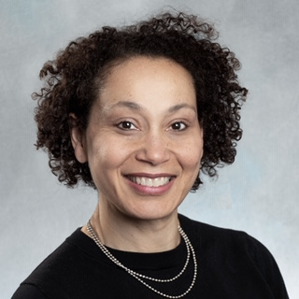
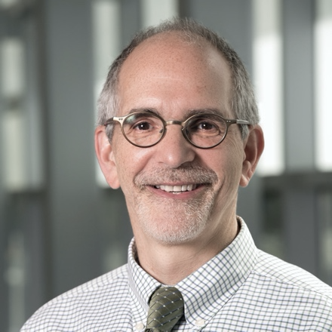
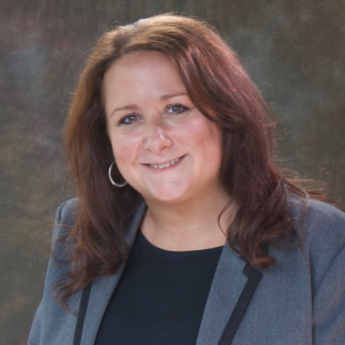
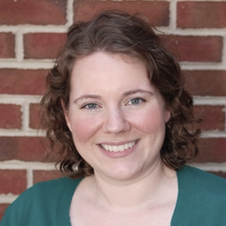
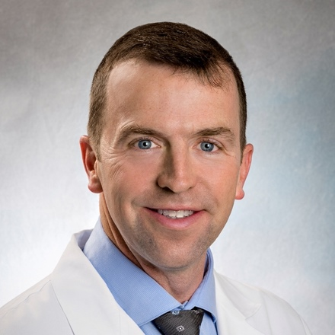
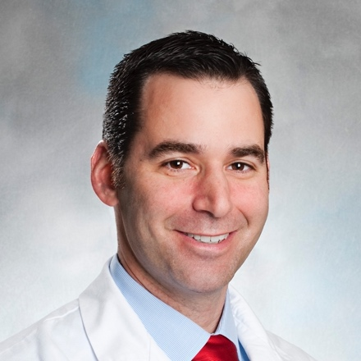
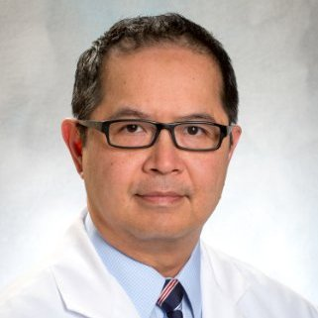
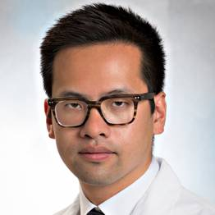
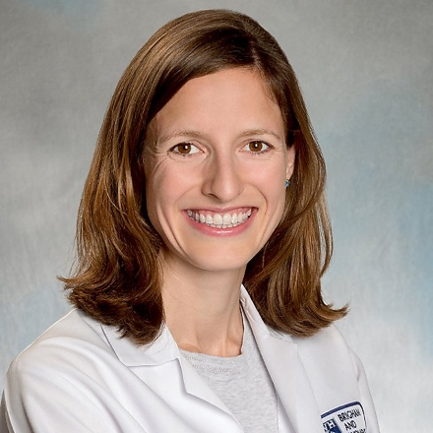
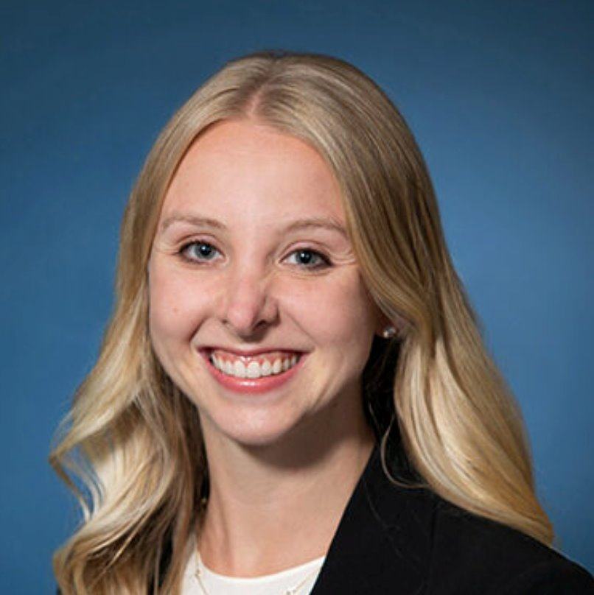
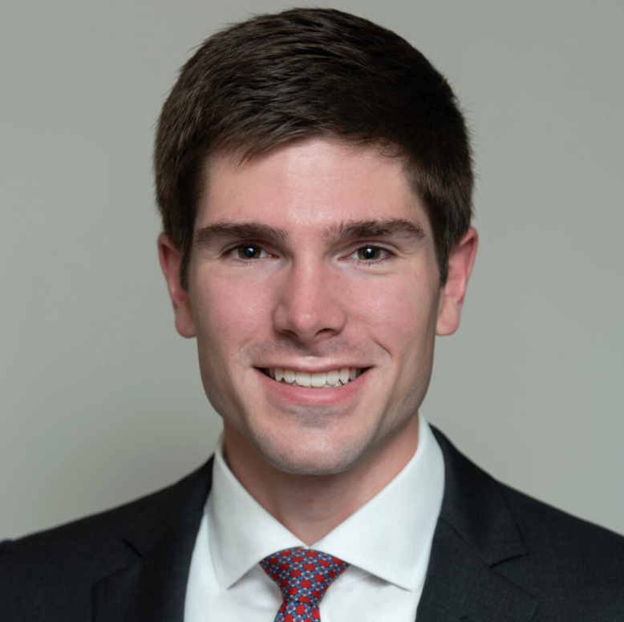
Current Internal Advisory Board Members
Zara Cooper, MD, MS
Kessler Director
zcooper@bwh.harvard.edu
Joel Weissman, PhD
Chief Scientific Officer
jweissman@mgb.org
Melissa Poleo, MS
Administrative Director
mpoleo@bwh.harvard.edu
Molly Jarman, PhD
mjarman@bwh.harvard.edu
Robert Riviello, MD, MPH
rriviello@bwh.harvard.edu
Eric Goralnick, MD, MS
egoralnick@bwh.harvard.edu
Stanley Ashley, MD
sashley@bwh.harvard.edu
Louis L. Nguyen, MD, MBA, MPH,
Fellowship Director
llnguyen@bwh.harvard.edu
Stu Lipsitz, ScD
slipsitz@bwh.harvard.edu
Quoc Dien Trinh, MD
qtrinh@bwh.harvard.edu
Regan Bergmark, MD
rbergmark@bwh.harvard.edu
Amanda Reich, PhD, MPH
ajreich@bwh.harvard.edu
Brittany Dacier, MD,
MPH
bdacier@bwh.harvard.edu
Alex Ordoobadi, MD
aordoobadi@bwh.harvard.edu

Slide 12
CSPH By the Numbers…
More than
100
Leaders in Academic Surgery Trained
More than
1,600
Peer-Reviewed Publications
More than
28M
in Grants and Awards
($5.5M in 2023)
54
Faculty
Members
18
Current Fellows
21
Full-Time Research Staff
17
Active Grants
40 full-time faculty members

Slide 13
Research Fellowship Program

Slide 14
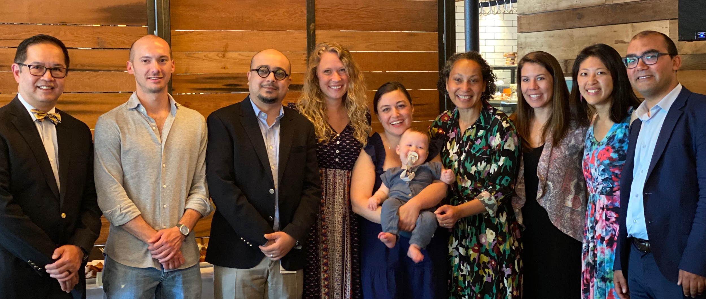
CSPH 2-Year Research Fellowship
As part of our mission, CSPH prepares future leaders in surgery and surgical health services research through a 2-year research fellowship for medical trainees, Master’s and PhD students.
For more information about the fellowship program, visit https://csph.brighamandwomens.org/fellowship/.
Prospective research fellows will identify a core or affiliate faculty member to be their primary or secondary mentor.
If you are interested in becoming a mentor, please reach out to Fellowship Director, Louis Nguyen, MD, MBA, MPH.

Slide 15
Fellowship Program: Mentor Responsibilities
Primary Mentors will:
Review and advise the research fellow’s Training & Mentorship plan
Conduct scheduled progress reviews and modify Training & Mentorship plan as necessary
Oversee fellow’s primary research (supporting grant)
Provide and/or identify funding mechanism for the fellow’s research
*Primary mentors must be a CSPH Core Faculty Member
Secondary
Mentor
Primary
Mentor
Fellow
Secondary Mentors or Co-mentors will:
Provide guidance and support in developing research methodologies and areas of interest
Support primary research or oversee secondary research as fellow’s time allows
*Secondary mentors can be faculty from any division, department, or institution as appropriate
Secondary
Mentor

Slide 16
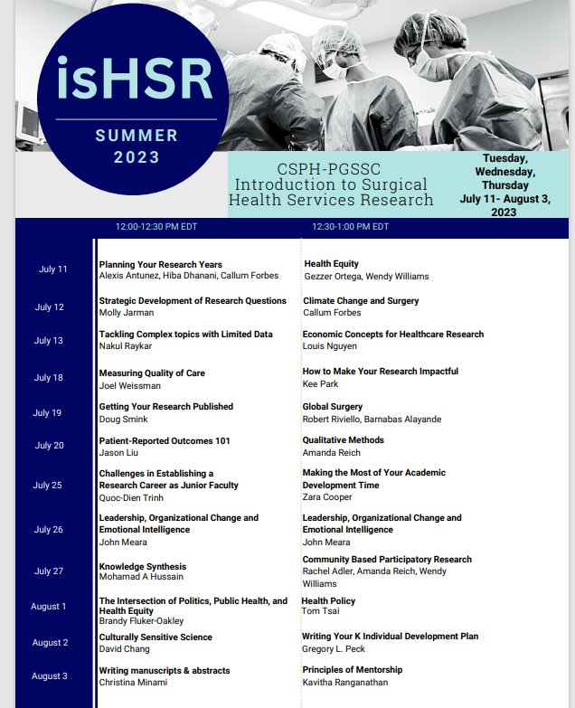
Resources for Research Fellows
Internal and External Educational Opportunities
Weekly Research Work-in-Progress Meetings
isHSR Summer Workshop
Meet the Faculty Series
Harvard Surgical HSR Speaker Series
Monthly Quantitative Methods Workshops
Monthly Qualitative Methods Workshops
R Course
Grant Development Meetings
Research and Data Support
Statistics and Programming/Coding Support (SAS, STATA, R)
Qualitative Data Consultation and Resources (ATLAS.ti)
Grant Management, IRB, Methods Review, and Research Admin Support
Media and Communications Support
Quantitative and Qualitative Workshops
Data Access (DUA dependent) and Data Management Support

Slide 17
CSPH MERITAS Fellowship
MERITAS (Mentored Research Training in Aging and Surgery) is a research training program in aging tailored to the unique needs of surgical residents. This program provides:
Rigorous training in health services research focused on aging and surgery
The opportunity to conduct research from concept to dissemination
Mentorship from investigators with multidisciplinary and methodological expertise
This program is open to surgical residents from any surgical specialty with an interest in researching aging. For more information about MERITAS, visit https://csph.brighamandwomens.org/meritas/.

Slide 18
Cores & Resources

Slide 19
At CSPH, we want you to be able to:
ACCESS EXPERTISE
LEARN AND BE INSPIRED BY OUR:
BUILD COLLABORATIONS
FACULTY
FELLOWS
RESEARCH STAFF
BIOSTATISTICIANS
PROJECT MANAGERS
ADMINISTRATIVE STAFF
DATA SCIENCE & BIOSTATISTICS
DATA
MANAGEMENT
& STORAGE
HEALTH POLICY & ADVOCACY
QUALITATIVE RESEARCH

Slide 20
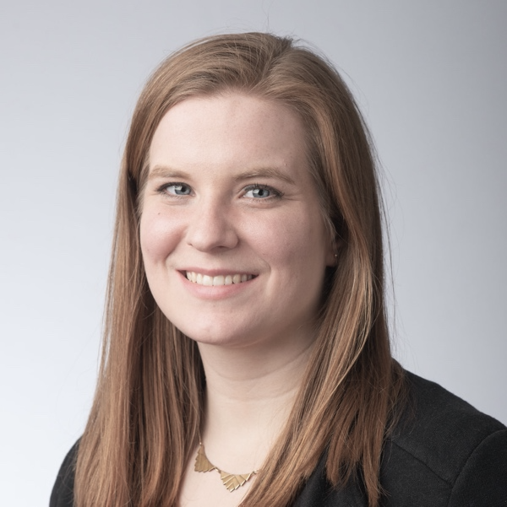
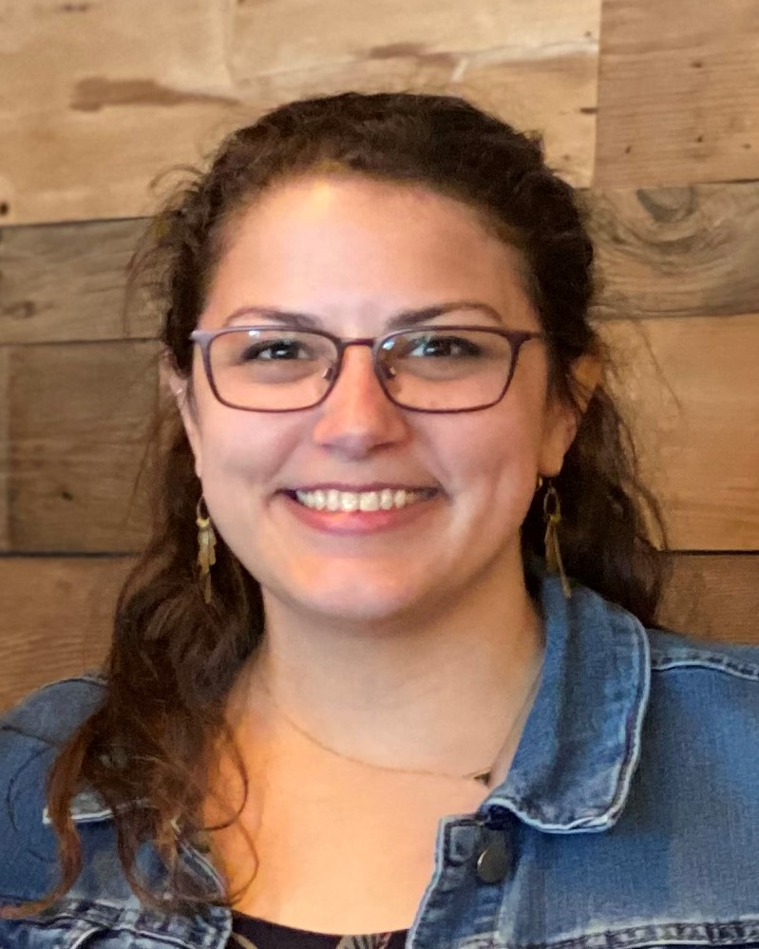
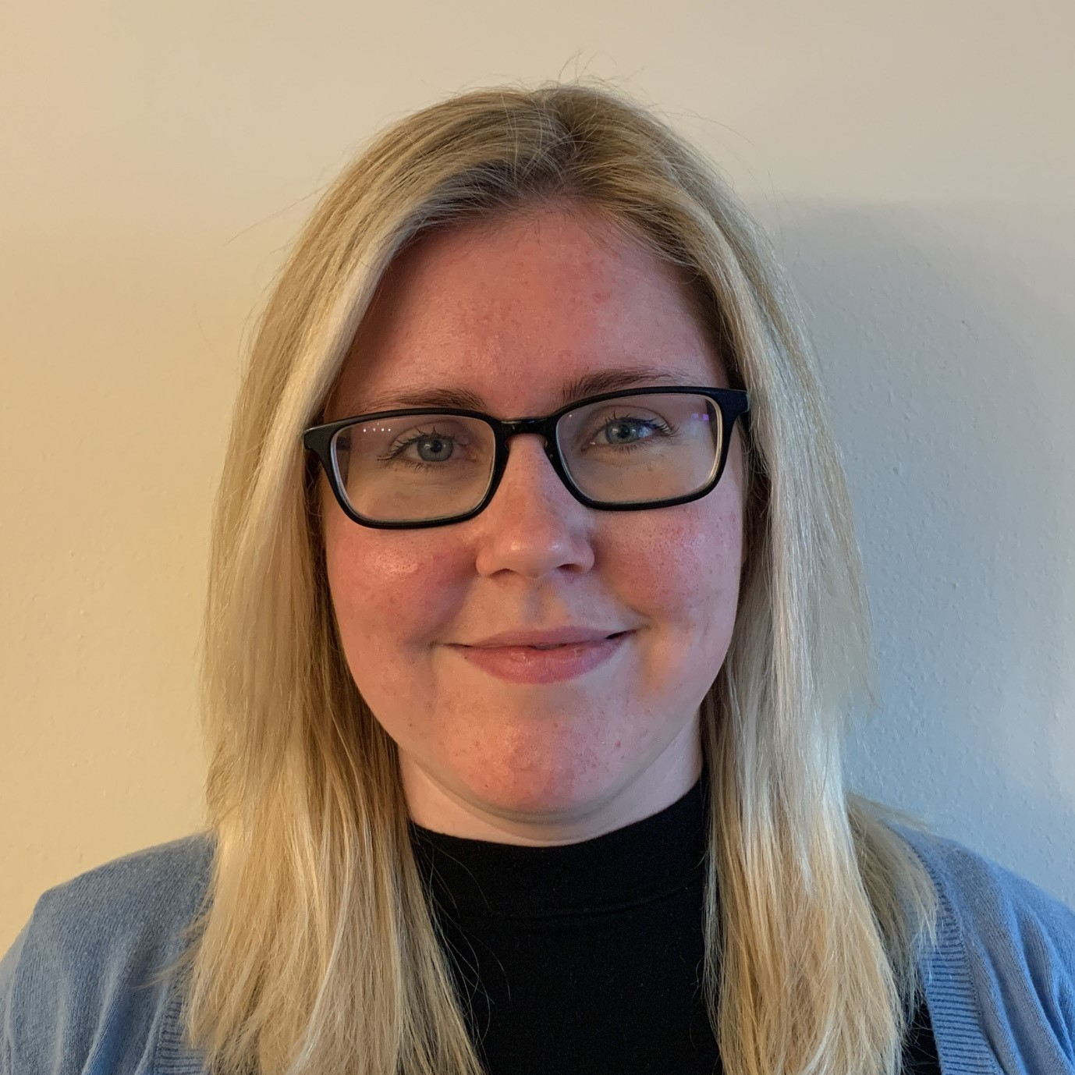
Research Management Core
The Research Management Core provides:
Administrative Support
Onboard new staff, research trainees, POI collaborators and fellows
Fellowship curriculum and experience support
Media and Communications Support
Collaborates with BWH Strategic Communications and DOS to support CSPH publications (e.g. press releases)
Manages social media (Website, Twitter)
Can help create visual abstracts and infographics
Archiving (publications, awards, presentations, etc.)
Grant Support
Grant Support, Pre/Post award
Monthly Grant Development Meeting
Specialized Services: Grant Writer
Rachel Murphy, MPH
Project Manager
rmurphy19@bwh.harvard.edu
Emily Stephens
Administrative and Fellowship
Coordinator
estephens2@bwh.harvard.edu
Alison Kou, MPH
Communications Specialist
akou@bwh.harvard.edu
Catherine McCarthy
Sr. Grants Administrator
cmccarthy7@bwh.harvard.edu

Slide 21
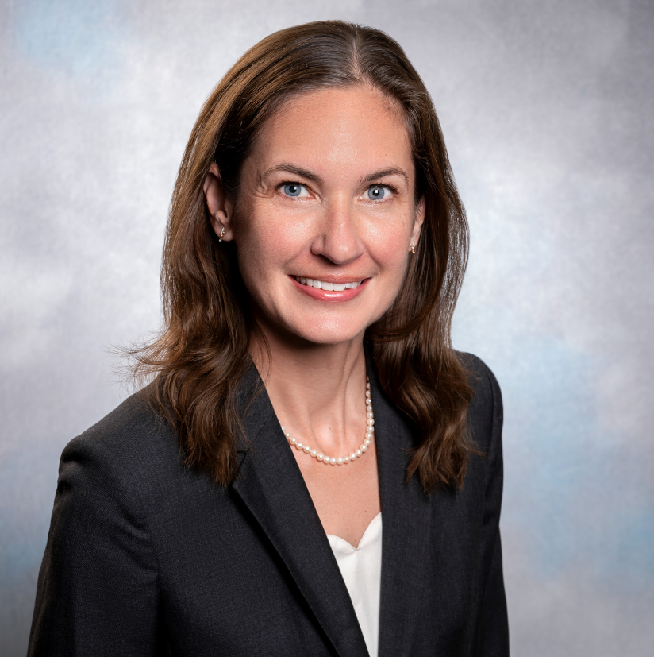
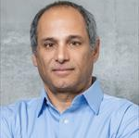
Qualitative Core
The Qualitative Core provides methodological consultations, workshops, and scientific support to support qualitative research at CSPH.
Consultations and workshops provide discussion, guidance and feedback on elements of all aspects of qualitative research including:
Writing Qualitative Research Aims
Study Design
Sampling, Recruitment, and Protection of Research Participants
Data Collection (Interviews and Focus Groups)
Data Management, Coding, and Analysis
Presentation of Qualitative Data
Amanda Reich, PhD, MPH
Qualitative Lead
ajreich@bwh.harvard.edu
Daniel Dohan, PhD
Qualitative Consultant
ddohan1@bwh.harvard.edu

Slide 22
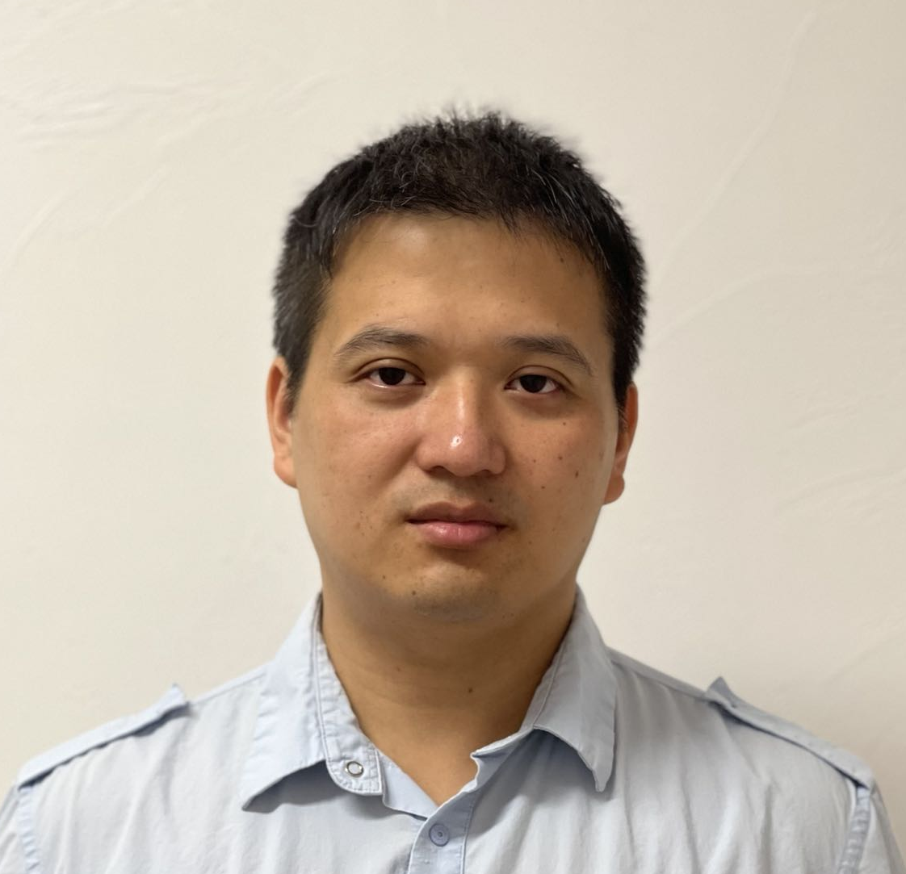
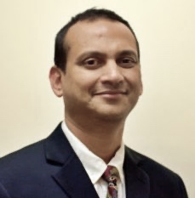
Quantitative Core
The Quantitative Core provides data infrastructure support to quantitative research at CSPH. This Core includes biostatisticians and researchers who are experts utilizing large national and state-level datasets to conduct surgical health services research.
This team of experts provides:
monthly workshops on topics related to quantitative methods and biostatistics
advice on projects via the Data and Data Management Teams Channel
Molly Jarman, PhD, MPH
Faculty Data Lead
mjarman@bwh.harvard.edu
Stu Lipsitz, ScD
Director of Biostatistics
slipsitz@bwh.harvard.edu
Kevin Chen
Database Manager
kchen35@bwh.harvard.edu
Tanujit Dey, PhD
DOS Faculty Biostatistician
tdey@bwh.harvard.edu

Slide 23
Training & Mentorship Core
The Training and Mentorship Core provides didactic and curriculum programming for CSPH fellows as part of developing them into future leaders in the field of surgical health services research.
The fellowship director:
Oversees the direction and development of the fellowship program
Provides, leadership, mentorship and support to research fellows
Louis L. Nguyen, MD, MBA, MPH
Fellowship Director
llnguyen@bwh.harvard.edu
Rachel Murphy, MPH
Project Manager, MERITAS Fellowship Program
rmurphy19@bwh.harvard.edu
Emily Stephens
Administrative and Fellowship Coordinator
estephens2@bwh.harvard.edu

Slide 24
Summary of Research Resources Available at CSPH
Qualitative Core can provide:
Methods review
Scientific support
Quantitative Core can provide:
Methods review
Scientific support
Data access and data management support (more info in following slides)
Research Management Core can provide:
Administrative support
Media and communications support
Grant support
See next slide for list of CSPH Didactic Events & Workshops.

Slide 25
Resources: CSPH Didactic Events
Meeting | Frequency, Day and Time
Research Weekly Works-in-Progress (WIP) Meeting | Weekly Tuesdays at 12:30-1:30PM
Post-WIP Meet the Faculty | Based on schedule (~5 times per year) Tuesdays at 1:30PM (after WIP)
Early Career Faculty Works-In-Progress (WIP) Meeting | Biweekly 2nd and 4th Tuesday at 2:00-3:00 PM
Qualitative Workshops | Monthly 3rd Thursday at 2:00-3:00PM
Statistics and Data Science Workshops | Monthly 1st Thursday at 2:00-3:00PM
Grant Development Meeting | Monthly 1st Tuesday at 2:00-3:00PM
Harvard Surgical Health Services Research (HSR) Speaker Series | Based on schedule (Visit https://csph.brighamandwomens.org/hsr/) Tuesday at 4:00-5:00PM
isHSR (Summer Research Methods Course) | Based on schedule (July/August) Tues-Thurs at 12:00PM

Slide 26
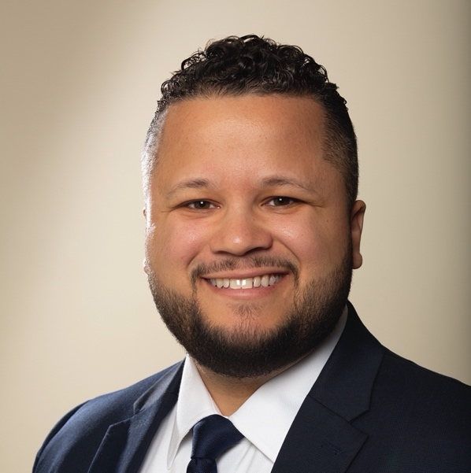
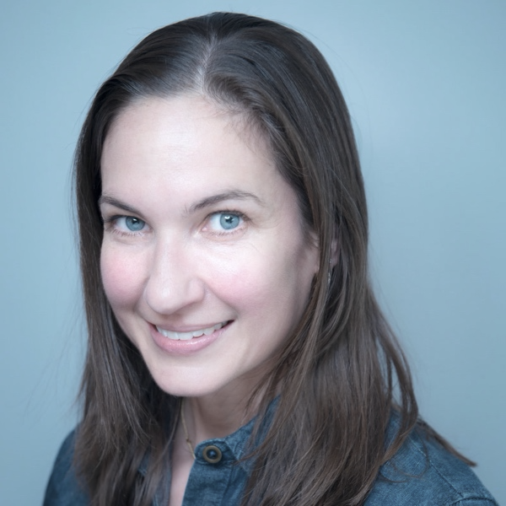
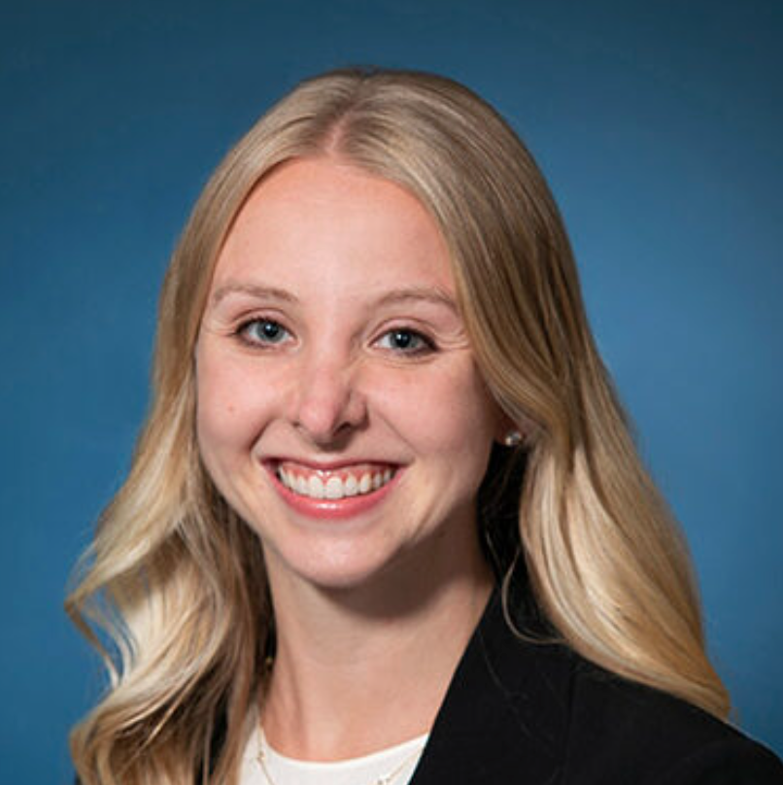
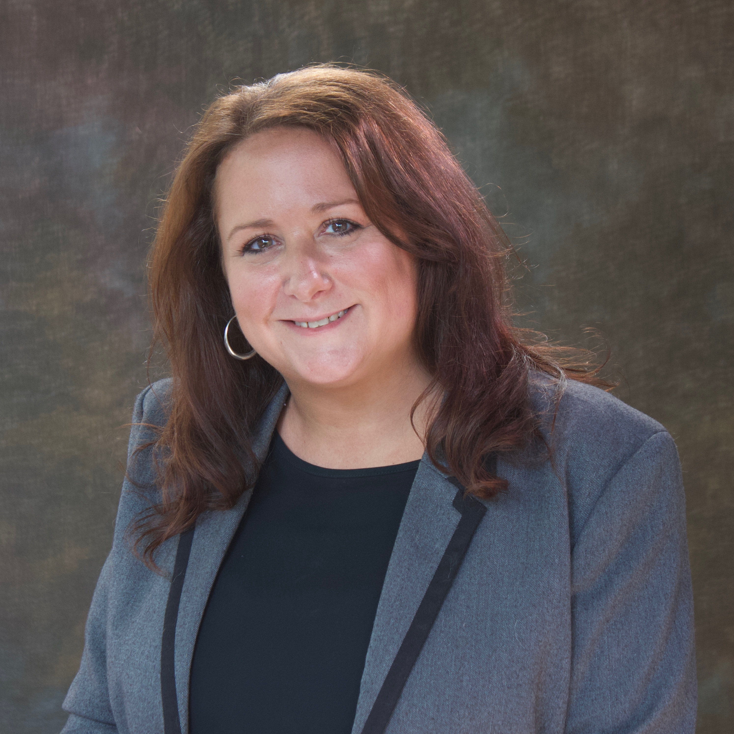
Points of Contact
Gezzer Ortega, MD, MPH
Research Faculty for Innovation for Equitable Surgical Care
gortega1@bwh.harvard.edu
Molly Jarman, PhD, MPH
Research Faculty for Health Informatics and Data Infrastructure
mjarman@bwh.harvard.edu
Amanda Reich, PhD, MPH
Qualitative Lead
ajreich@bwh.harvard.edu
Brittany Dacier, MD, MPH
Lead Research Fellow
bdacier@bwh.harvard.edu
Alex Ordoobadi, MD
Lead Research Fellow
aordoobadi@bwh.harvard.edu
Louis L. Nguyen, MD, MBA, MPH
Fellowship Director
llnguyen@bwh.harvard.edu
Alison Kou, MPH
Communications Specialist
akou@bwh.harvard.edu
Rachel Murphy, MPH
Project Manager
rmurphy19@bwh.harvard.edu
Emily Stephens
Administrative and Fellowship Coordinator
estephens2@bwh.harvard.edu
Melissa Poleo, MS
Administrative Director
mpoleo@bwh.harvard.edu

Slide 27
Data Acquisition Process

Slide 28
Data Access and Data Management Support
CSPH also provides Data Access and Data Management Support, including:
Access to large catalog of administrative data (Note: Data access is DUA dependent)
Secure storage and computing environment with common software packages installed (SAS, Stata, R, ATLAS.ti)
Expert guidance for study design, data selection/acquisition, analytic plan
Includes integrated NCDB application support
Coordination of part-time/time-limited biostatistician support
Requirements for data access:
IRB approval or formal determination that project is not human subjects
Documentation of relevant Data Use Agreements
MGB credentials for anyone accessing server – employee or POI trainee
Access with personal computer requires additional documentation
Offsite access requires VPN connection to MGB network

Slide 29
How to Access CSPH Data Core
This is CSPH’s integrated process for all data/support requests:
CSPH Analyst
Assigned
Data Service Intake Survey (RedCap)
CSPH Data &
Methods Meeting
Work Plan & Project Documentation
Project
Deliverables
Submit basic project information through this survey
Link to survey here: https://redcap.partners.org/redcap/surveys/?s=KE8LY48JLJJT8CYC
Projects are reviewed every Wednesday
Projects are triaged and assigned to the appropriate team member
Depending on project scope, complete:
Detailed project planning form
Funding information
Compliance documentation (IRB, DUA)
At end of project, archive with CSPH:
Copy of final SAS/Stata/R code
Output from statistical program
PDF of accepted article

Slide 30
Data Sets Available at CSPH
Healthcare Cost and Utilization Project
National Inpatient Sample 1988-2019
Kids’ Inpatient Database *Select years from 1997-2019
Nationwide Emergency Department Sample 2006-2019
Nationwide Readmissions Database 2010-2019
State Inpatient Database (32 states)
State Emergency Department Databases (11 states)
State Ambulatory Surgery and Services Databases
(8 states)
National Ambulatory Surgery Sample (NASS) 2016-2019
American Hospital Association Linkage Files *Select years from 2006-2016
American Hospital Association Annual Survey Database 2014, 2016, 2018-2020
National Emergency Medical Services Information System 2016
Medicare – NTDB Standard (traumatic injury diagnoses) 2013-2016, 2018
National Trauma Data Bank 2007-2016
TQP 2007-2019
Trauma Information Exchange Program (TIEP) 2017
SEER-Medicare
NSQIP (data storage and analysis)
TRICARE 2006-2018
TRICARE is the healthcare insurance program for uniformed service personnel, their dependents, retirees, and retiree beneficiaries in the United States. Patients enrolled in TRICARE receive comprehensive medical coverage through either the Direct Care System (military facilities) or purchased care (civilian hospitals). The dataset includes administrative (i.e., billing) records for the entirety of their care.
For more information, please email Alyssa Jones
ajones61@bwh.harvard.edu

Slide 31
CSPH Faculty Expectations

Slide 32
Faculty Requirements
 | Core Faculty | Affiliate Faculty
Mentorship | Provide primary or secondary mentorship to early career faculty, fellows, and students | Mentor fellows and early career faculty as part of the mentoring team.
Attendance | Frequently attend recurring CSPH events/activities (i.e., Weekly Works-in-Progress, Grant Development, HSR Speaker Series, Early Career Faculty Meetings, social events, etc.). | Attend recurring CSPH events/activities at least twice per year (i.e., Weekly Works-in-Progress, Grant Development, HSR Speaker Series, Early Career Faculty Meetings, etc.).
Credit CSPH | Credit CSPH on publications, proposals, and media. | Credit CSPH on publications, proposals, and media if submitted through/supported by the Center.
Staff | Have research staff and trainees located and/or affiliated with the CSPH | N/A
Grants | Have active projects utilizing and supporting CSPH resources or submit at least one grant application every other year (as PI, Co-I, mentor) that utilizes CSPH resources Include CSPH resources and staff in grant submission funding | N/A

Slide 33
Research Dissemination & Media Guidelines
If you have a paper accepted, please share the following information with Alison Kou (CSPH Communications Specialist):
CV-ready citation (all authors, title, journal, acceptance date)
Copy of the manuscript/abstract
3-5 key messages
Anticipated publication date
Your dissemination strategy: will you need a visual abstract, infographic, press release, or social media support? All requests should be made at least 2 weeks in advance of publication.
If you have been contacted for interviews, podcasts, or are writing an op-ed, please reach out to Alison Kou. If external media has already reached out to you, please contact Jessica Pastore, BWH Director of External Communications, for support and guidance, and inform Alison Kou.
Alison Kou akou@bwh.harvard.edu
Jessica Pastore jpastore@bwh.harvard.edu

Slide 34
Thank you!
For questions, please contact Melissa Poleo
mpoleo@bwh.harvard.edu
Website: csph.brighamandwomens.org
Twitter: @CSPH_BWH

